Slide 1
World of Tank
Zhe Lu
Ting Wang
Xiaoqiao Mu
Ming Ma

Slide 2
Introduction
This is a competitive game between two players
Player 1(Green Tank) and player 2(Red Tank)
Movement of tanks are controlled by keyboard
How to win the game
Green tank or Red tank is attacked by bullets three time
The base of green tank or the base of red tank is destroyed
Tips about how to win
Pay more attention on the monsters because they can shot bullets also.
Try your best to destroy the base of your opponent

Slide 3
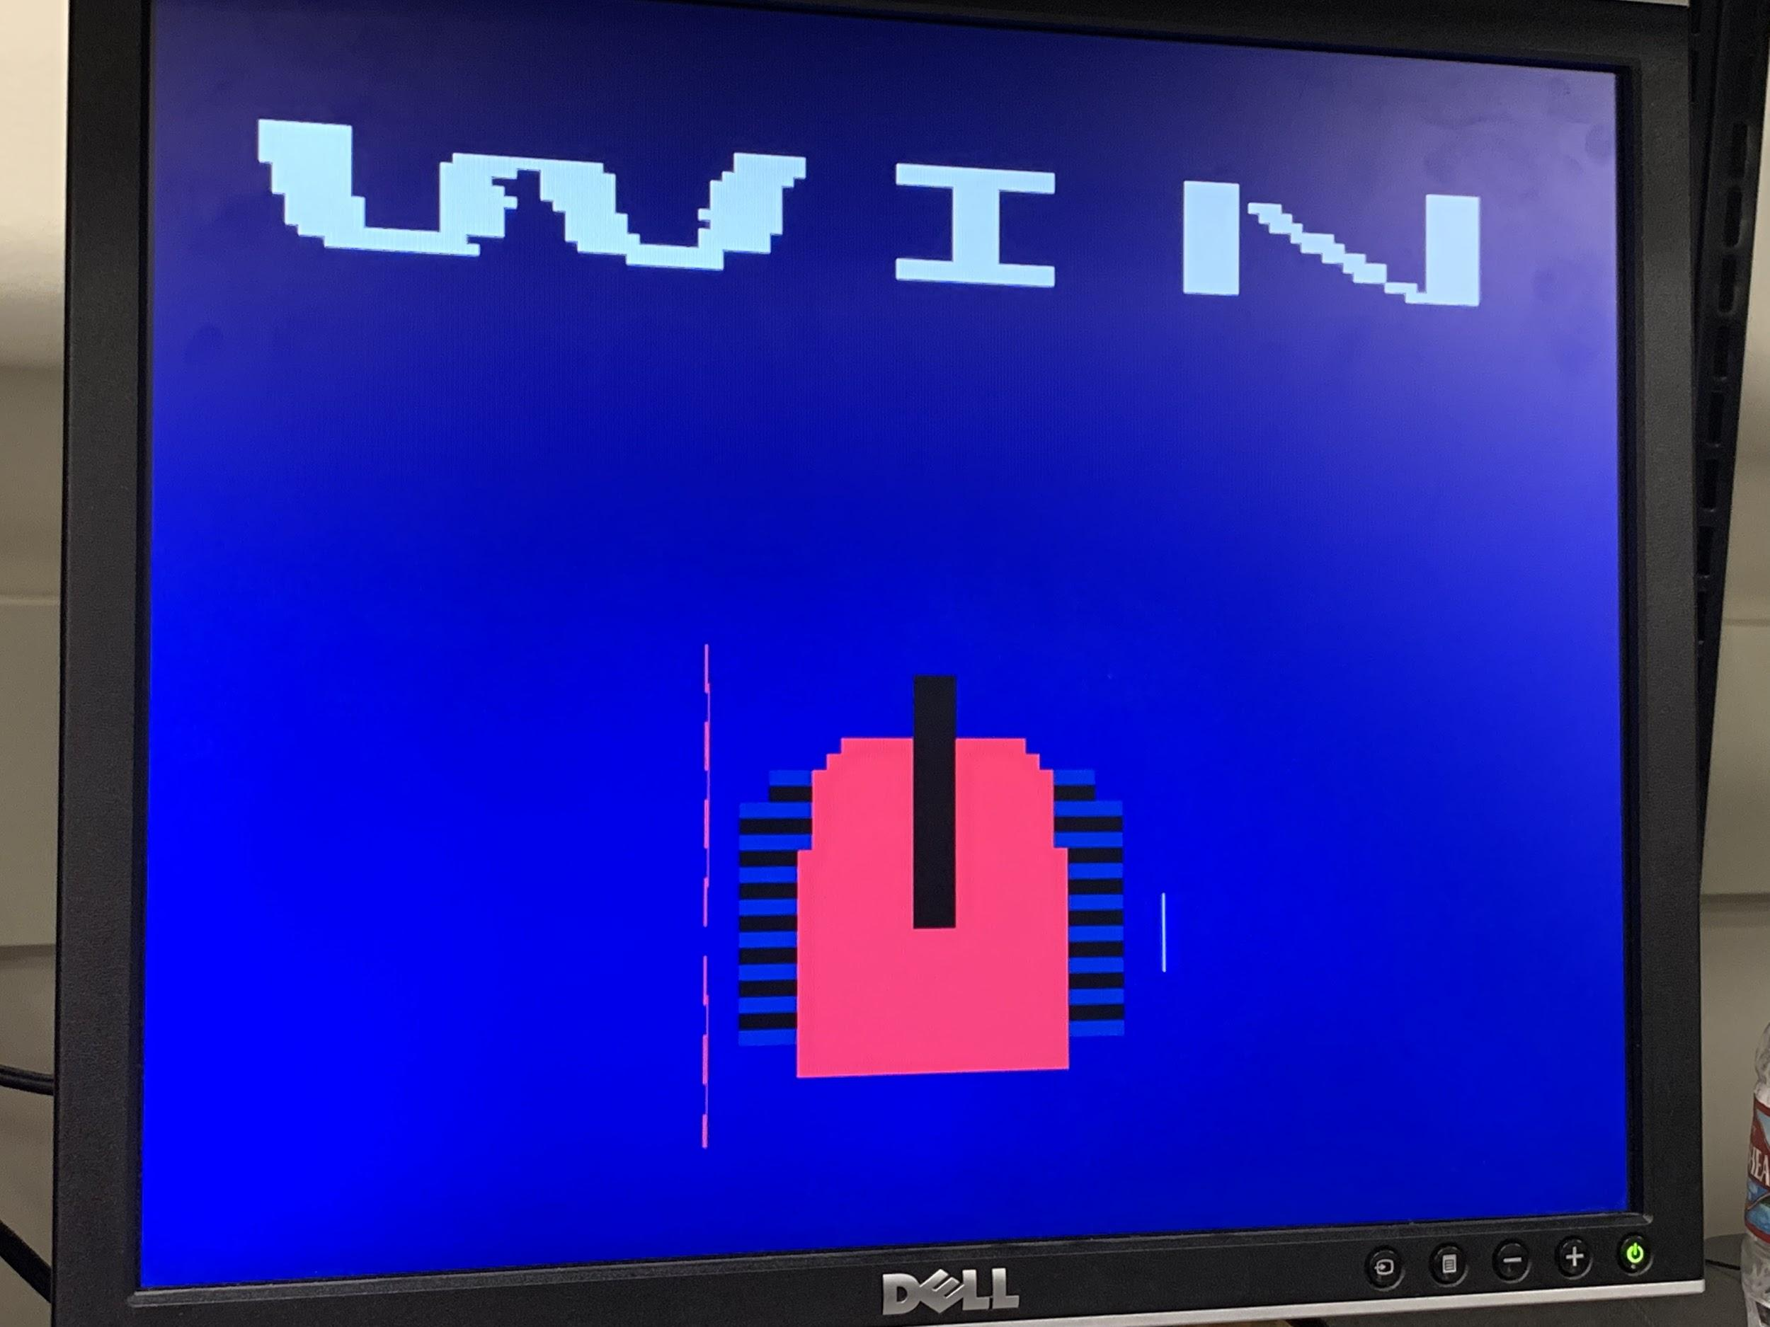
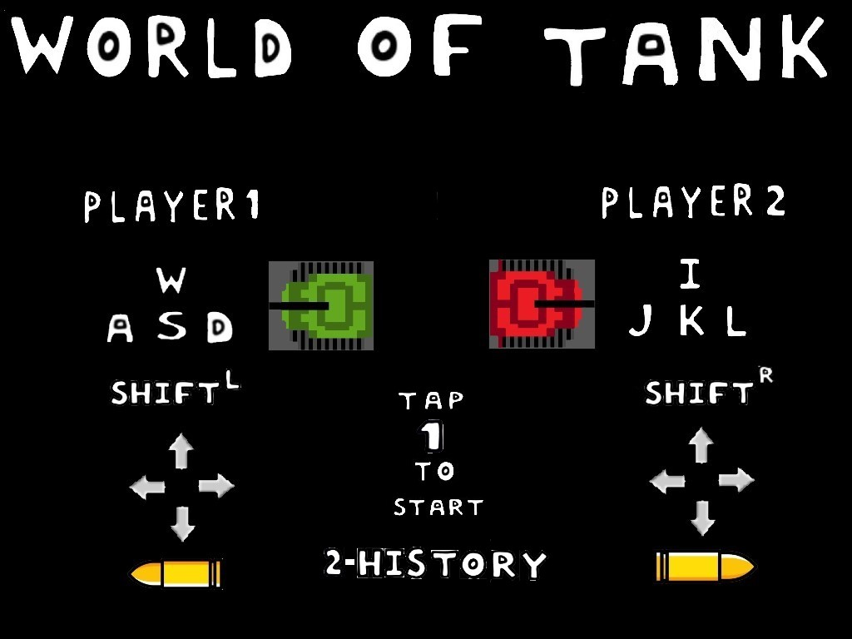
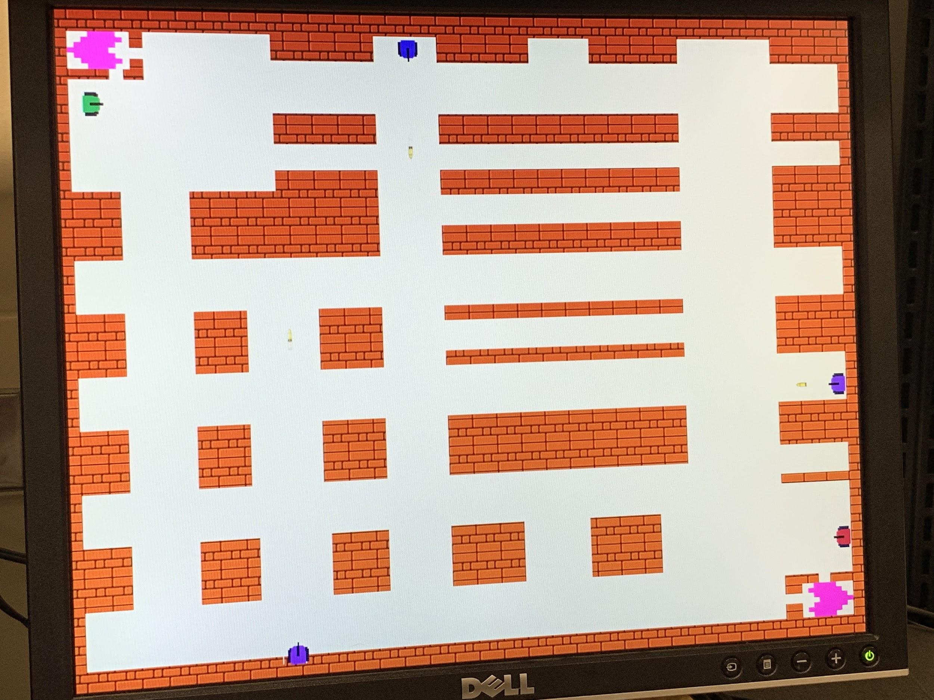
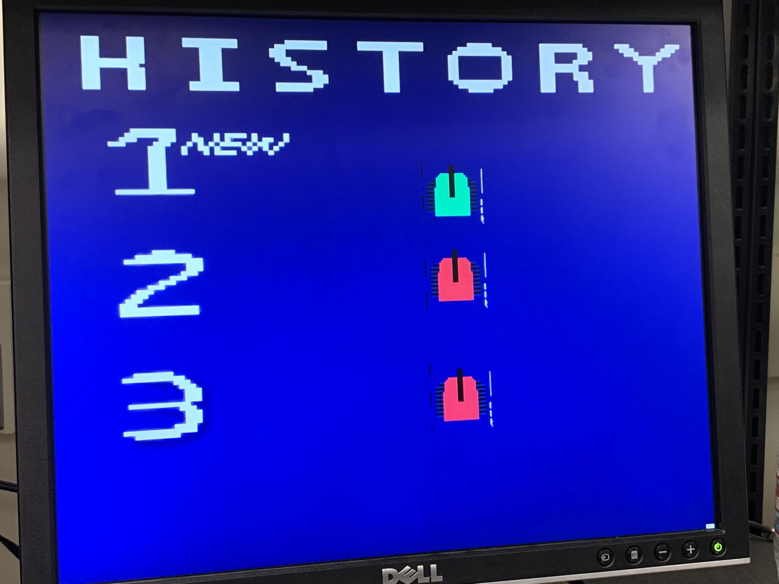
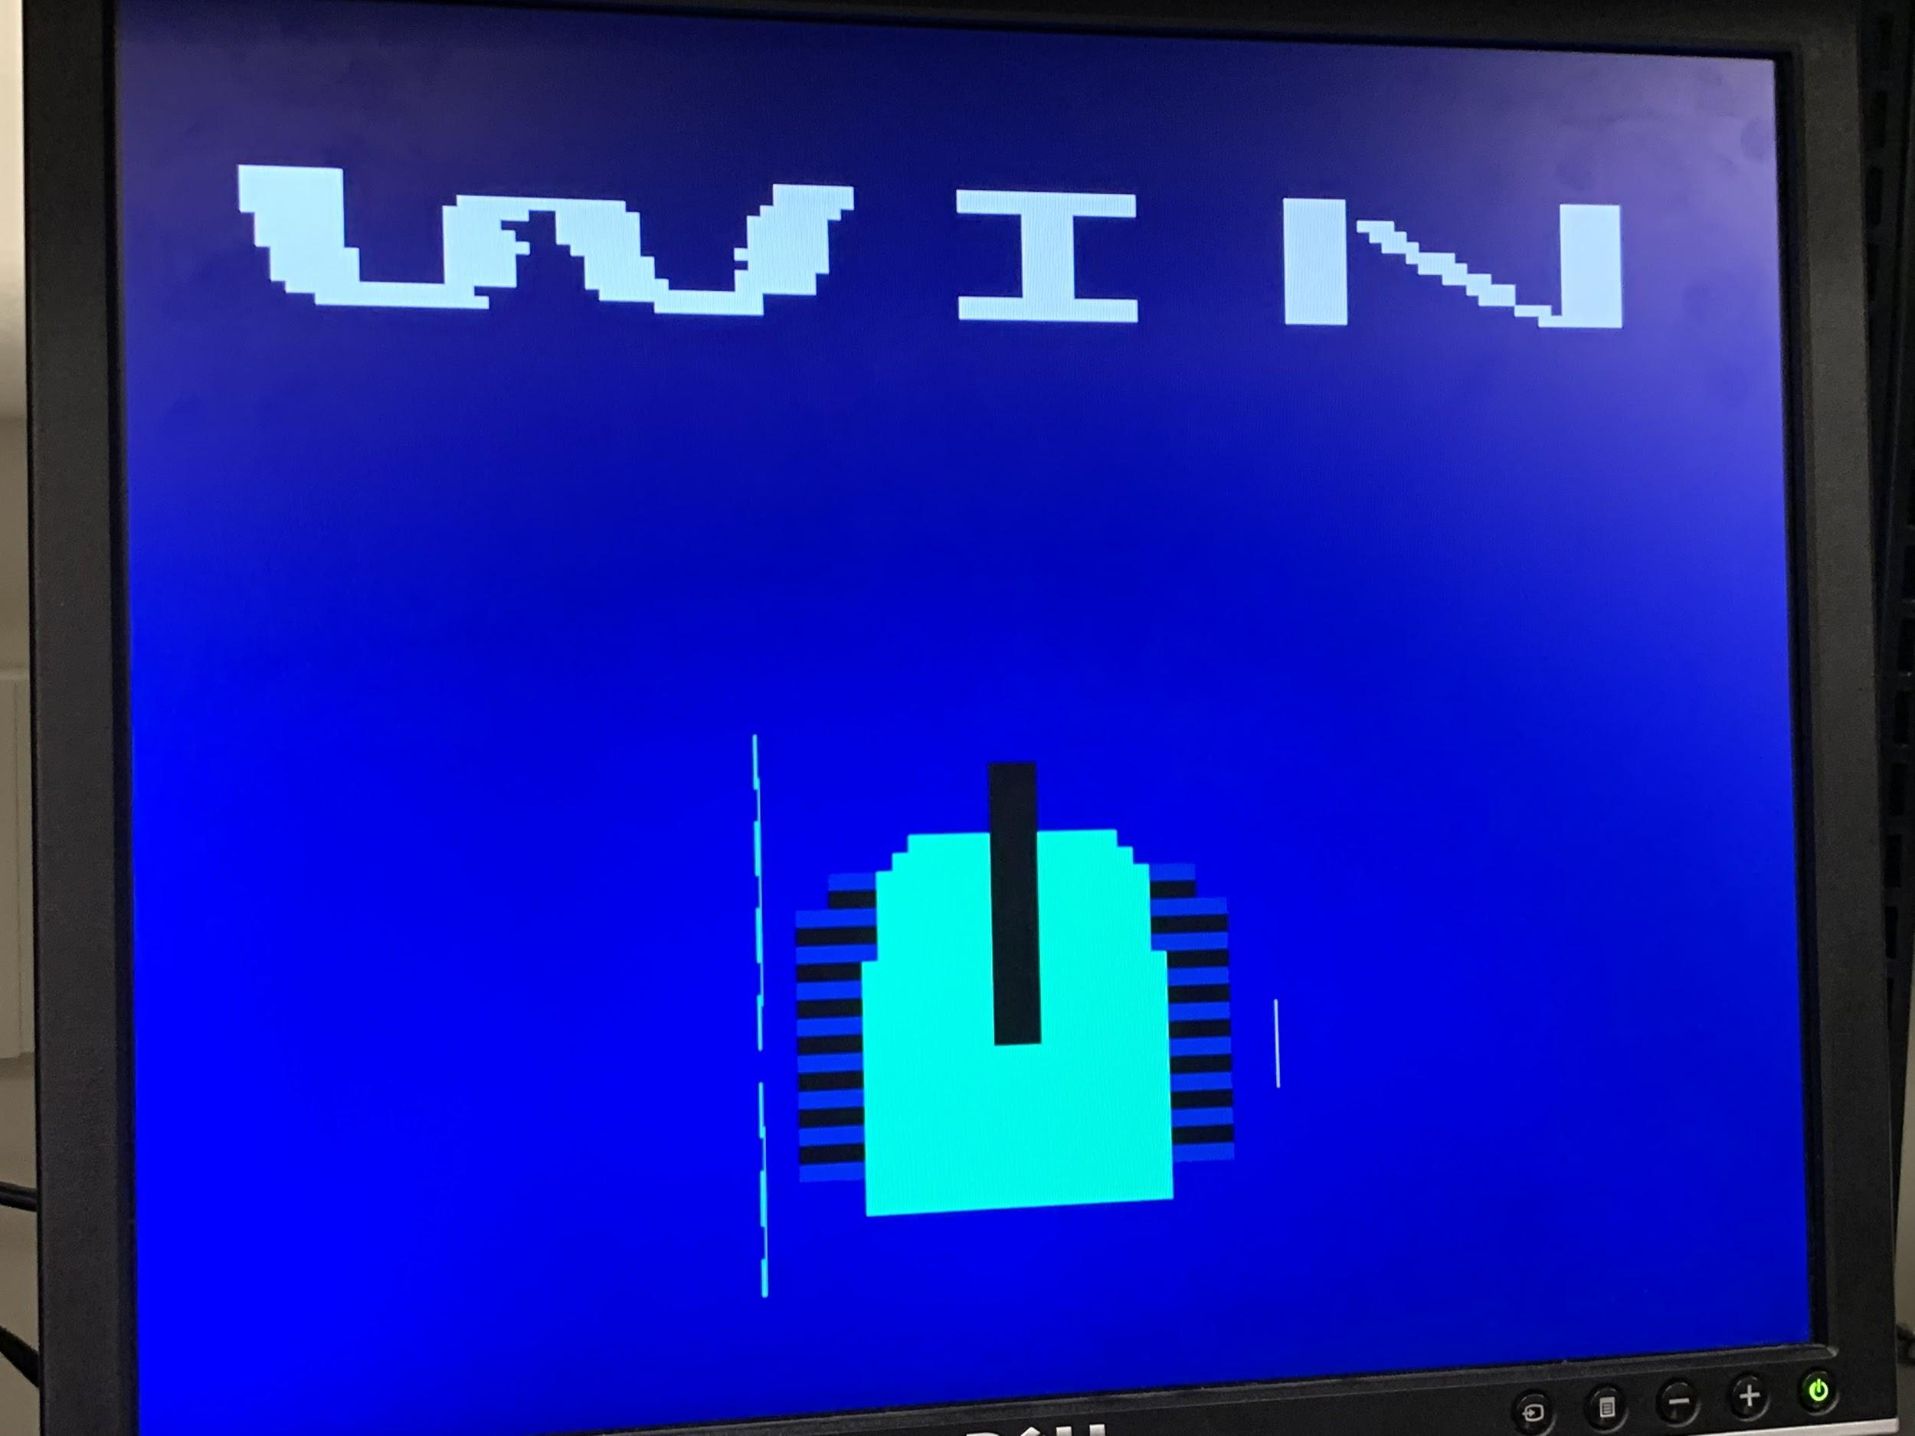
Game Procedure
Tap 2
Tap Space
Tap 1
Tap Space
Tap Space

Slide 4
.coe File
World map ------>.coe file
Reference from class material
Using mapit_coe.pl generate .coe files
JPG ------>.coe file
Matlab
https://www.mathworks.com/matlabcentral/fileexchange/39805-image-to-coe-converter

Slide 5
Hardware Flowchart
H_sync
v_sync
myp_sys.v
IO_BotCtrl
DTG.v
Audio .v
Audio output
IO_BotInfo
IO_HIT
DTG.v
DTG.v
IO_Bullet
Bot_31.v
World map.v
IO_Frame
DTG.v
Colorizer.v
IO_History
Icon.v
RGB
IO_keyboard
keyboard.v
keyboard.v
DTG.v
Bullet.v
DTG.v
Bot_31.v
monster.v

Slide 6
Hardware
Bullet.v
Icon.v
Colorizer.v
reset
stop=1
hit?
Introduction frame
shot?
Game frame
icon=tank
icon=brust
stop=0
Winner frame1
Winner frame2
bullet=1&& world=2?
History frame
stop=1

Slide 7
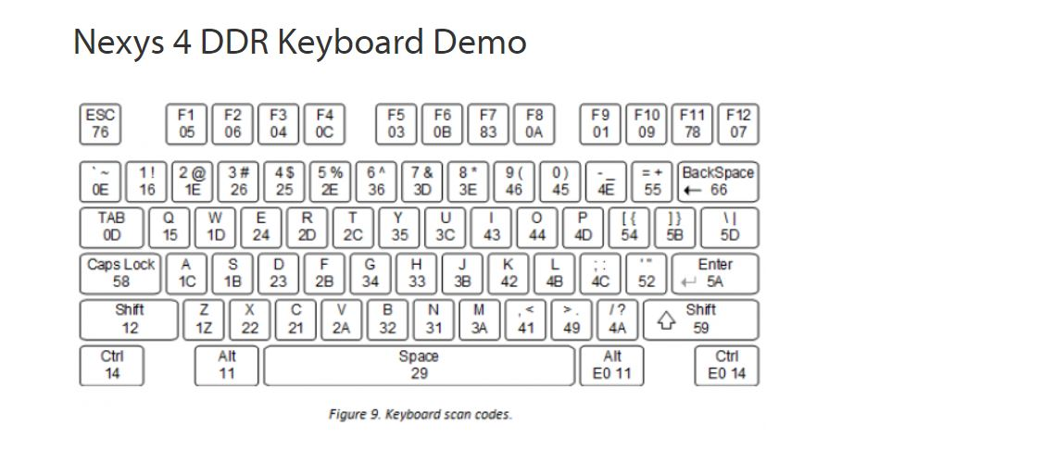
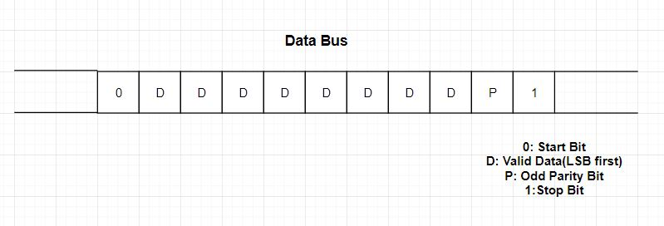
Keyboard Interface
PS/2-style keyboard
W：1D(Hex) → F0(Hex) -> 1D(Hex)
https://reference.digilentinc.com/learn/programmable-logic/tutorials/nexys-4-ddr-keyboard-demo/start

Slide 8
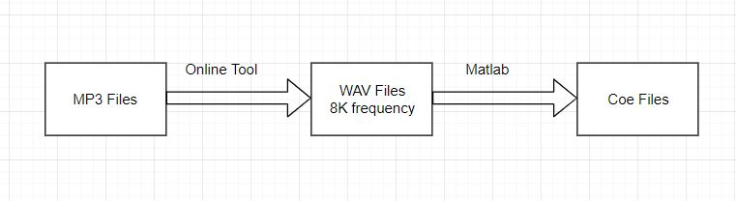
Audio
AUD_PWM=1’b1 if data_in>Pwm_Count
AUD_SD = 1’b1 (Shutdown)
Initial Page: background_reduced.ceo
Fight Page: start_background_reduced.ceo
MP3 to WAV website: https://audio.online-convert.com/convert-to-wav
WAV to Ceo reference: https://github.com/gajjanag/6111_Project/tree/master/assets/audio_convert

Slide 9
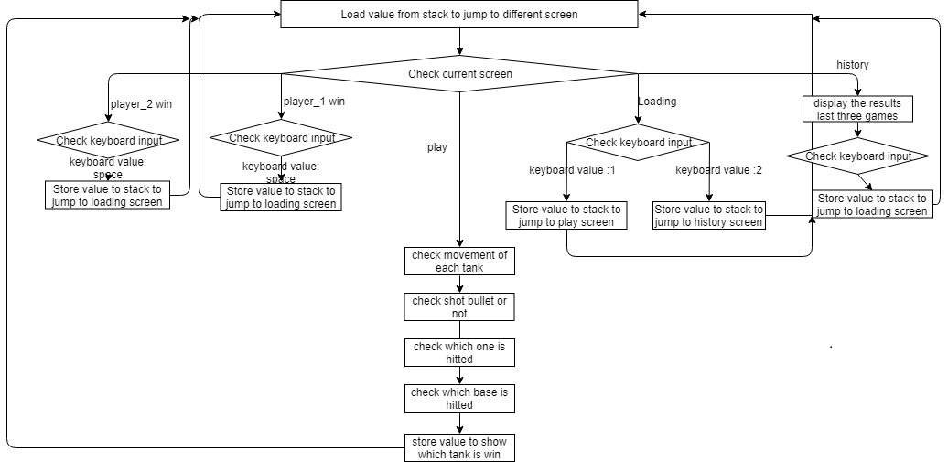
Software Flowchart

Slide 10
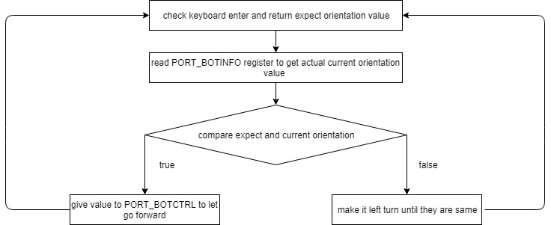
Software Flowchart:Movement

Slide 11
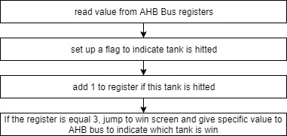
Software Flowchart: Check hitted

Slide 12
Contribution
Zhe Lu: Game algorithm part(software)
Ting Wang: Icon, Rojobot, bullet, colorizer and monster module
Xiaoqiao Mu: Image generation and hardware integration
Ming Ma: Audio module and keyboard interface

Slide 13
Future Work
Monsters move automatically
Improve image resolution and fix the unexpected line in tank icon
Add Wifi module
Improve the usage of memory-use memory more efficiently.

Slide 14
Questions?

Slide 15
Demonstration Time!

Slide 16
Thank you!

